Slide 1
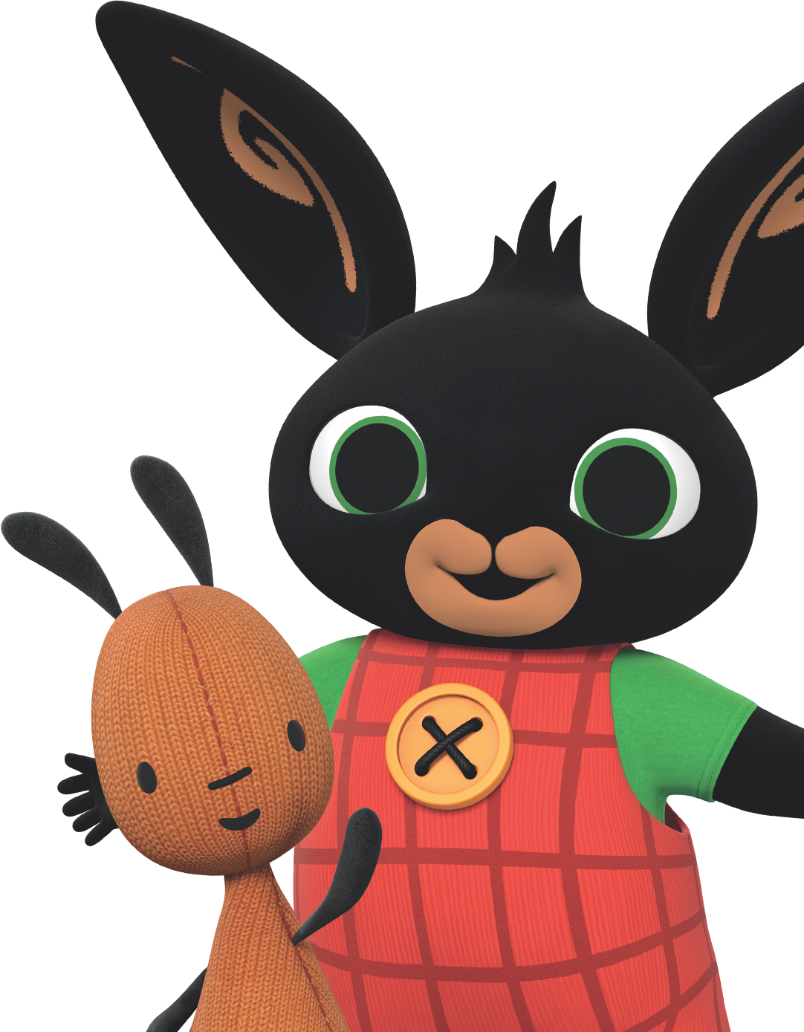
12 Tips for Potty Training Out and About
Supporting your child to use the toilet away from home is an exciting step on their potty training journey. For the first few days of not wearing a nappy however, it will help to stay at home if you can. This will make it easier for your child to focus on what you’re helping them to learn.
Once you’re ready to get out and about, here are some tips to prepare your child and make nappy free trips easier to manage:
Make a plan
Keep the first trips out short and to places you know well. Choose somewhere that has easy to access toilets nearby.
Talk to your child about the new experiences they will have. Explain how things such as the flush and taps at the supermarket or park might work differently from the one at home or nursery for example.
Hand dryers, especially the ones that start automatically, can sometimes frighten little children. Help your child get used to hearing them go off when you are using public toilets.
Go prepared
You don’t need to buy lots of new accessories, but a travel potty and washable car seat cover can come in handy. Some parents choose to take their toilet training seat from home.
For more resources,
go to bingbunny.com
© 2023 Acamar Films Ltd.

Slide 2
12 Tips for Potty Training Out and About
Encourage your child to get used to sitting on the portable potty or seat at home so they know how it feels.
Pack a bag with plenty of spare pants, trousers, toilet paper and wipes. A plastic bag for damp clothes can be handy too.
Dress your child in clothes that are easy for them to push down and pull up again.
Accidents will happen
Try not to panic if your child suddenly announces that a wee is coming in the middle of the park or a shop. You won’t be the first or last parent to deal with a puddle in public!
Accidents are all part of potty training experience and an important part of how your child learns what they need to do. Use accidents as a teaching opportunity to help them understand how to get to the potty or toilet before it’s too late. Keep calm and help them to get cleaned up.
Avoid putting your child back in a nappy or a pull up for a trip out as being in something that feels like a nappy can be confusing for them and undo all that great learning you’ve done together.
It’s easy to lose track of the time when you’re out and your child is busy playing. Encourage them to use the potty or toilet if it’s been an hour or so since they last went.
Give your child lots of praise and encouragement for all the effort they make when using the potty or toilet away from home.
For more resources,
go to bingbunny.com
© 2023 Acamar Films Ltd.

Slide 3
12 Tips for Potty Training Out and About
This is a lovely way to show them how proud you are of their growing independence and to keep them motivated.
About ERIC:
ERIC, The Children’s Bowel & Bladder Charity is dedicated to helping all children and teenagers manage and overcome distressing continence conditions. Whether it is a toilet-training issue, bedwetting, constipation or soiling problem, ERIC provides expert support, information and understanding to children and young people and enables
parents, carers and professionals to help them establish
good bowel and bladder health.
ERIC’s family support includes a free helpline, parent and family workshops, online resources and information.
Helpline: 0808 169 9949 open Monday – Thursday: 10am – 2pm
Website: www.eric.org.uk
For more resources,
go to bingbunny.com
© 2023 Acamar Films Ltd.

